Slide 1
Bank Marketing Classification
Group members:

Slide 2
OVERVIEW
Explanation of the Bank Marketing Dataset
Data Cleaning and Dataset Visualization
Algorithms and Techniques
Comparison for the ML techniques
Conclusion

Slide 3
1. Explanation of the Bank Marketing Dataset
The data is related with direct marketing campaigns (phone calls) of a Portuguese banking institution.
Problem Statement:
This project utilizes three types of Machine Learning algorithms to check if the client has subscribed for a term deposit depending on various bank marketing attributes like age, type of job, education level, if the client has a housing loan or not, last date of contact, etc.

Slide 4
Data Description
Number of Instances | Number of input | Input Categories | Output
4521 | 16 | 6 categorical, 3 binary 7 Numeric | Binary(yes or no)
Attributes names | Attributes types | Description
job | categorical | admin.","unknown","unemployed","management","housemaid","entrepreneur","student","bluecollar","selfemployed","retired","technician","services"
marital | categorical | married","divorced","single"; note: "divorced" means divorced or widowed
contact | categorical | contact communication type:unknown","telephone","cellular"
education | categorical | unknown","secondary","primary","tertiary
month | categorical | last contact month of year :”Jan", ”Feb", ”Mar", ..., ”Nov", ”Dec")
poutcome | categorical | outcome of the previous marketing campaign: "unknown","other","failure","success"

Slide 5
Data Description
Attributes names | Attributes types | Description
age | Numeric | age of every client
day | Numeric | last contact day of the month
balance | Numeric | average yearly balance
duration | Numeric | last contact duration, in seconds
campaign | Numeric | number of contacts performed during this campaign and for this client
pdays | Numeric | number of days that passed by after the client was last contacted from a previous campaign( -1 means client was not previously contacted
previous | Numeric | number of contacts performed before this campaign and for this client
default | Binary | has credit in default?"yes","no"
housing | Binary | has housing loan?
loan | Binary | has personal loan?
Output | y | binary: YES or No

Slide 6
2.Data preparation
Checking miss values
Label encoding
Data Visualization
Data balance and feature scaling
One hot encoding
Label encoding for the categorical attributes. Binary attributes are converted to either 0 or 1, which can better help to get data visualization graph and heatmap.
Our dataset do not have missing data.
Remove the useless attribute: default pdays.
Balancing the output data and scaling the attributes.
.
www.free-powerpoint-templates-design.com

Slide 7
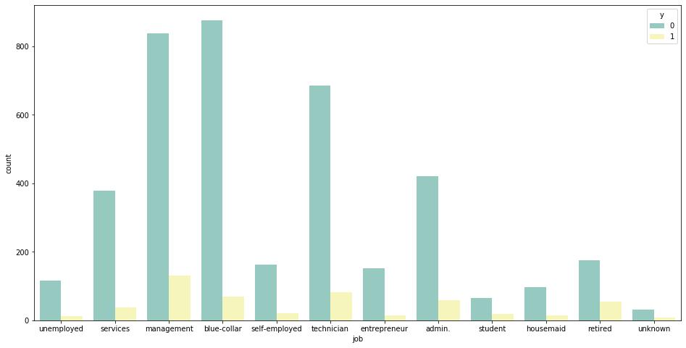
2.Data Visualization
Job attribute: the people who worked in management has more interest in deposits

Slide 8
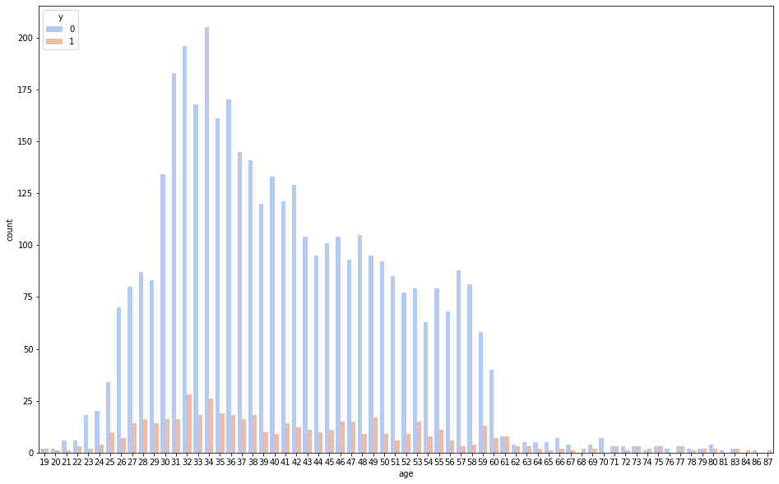
Age attribute: the people who aged from 25 to 65 has subscribed for a term deposit

Slide 9
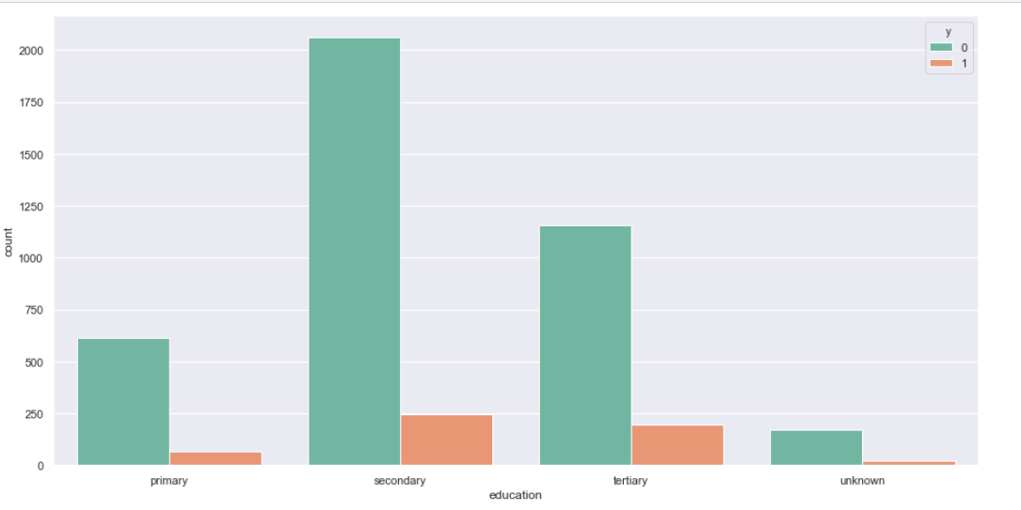
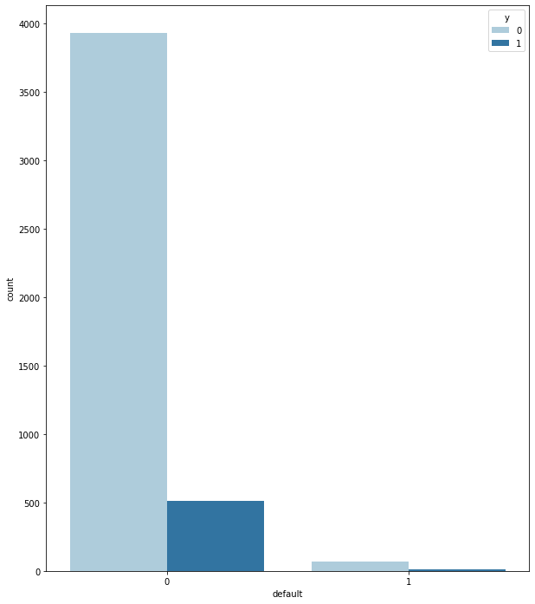
Education & Defaults
503
21

Slide 10
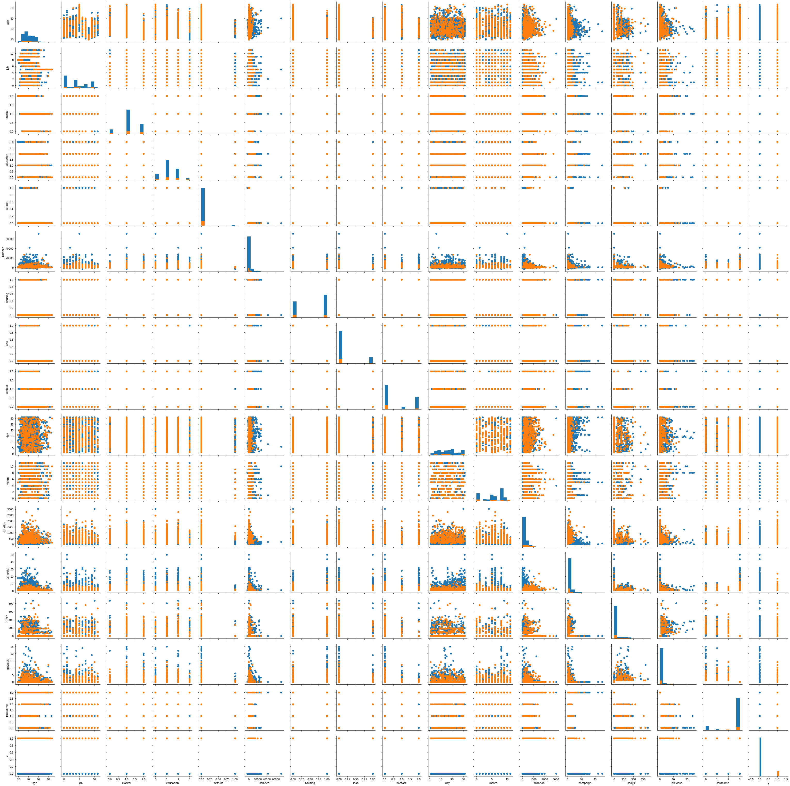
Pair Grid
Pair Grid shows relationship between each attribute and output
From graph, it does not show very strong liner relationship with each attributes
In order to better measure their correlation, the heatmap can be used as another method.

Slide 11
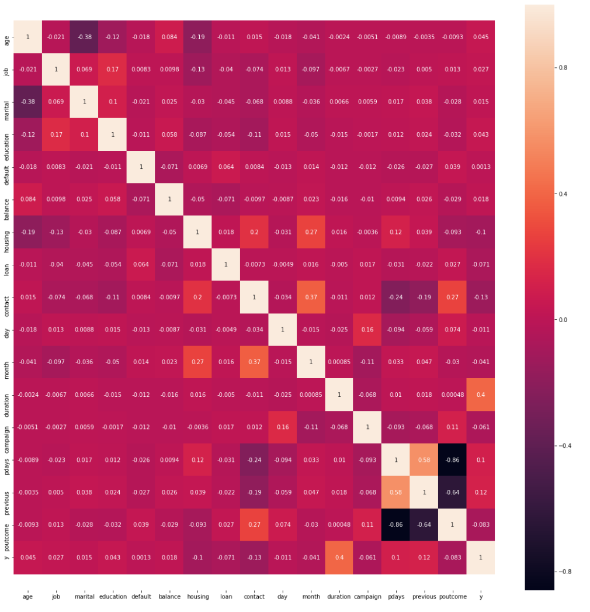
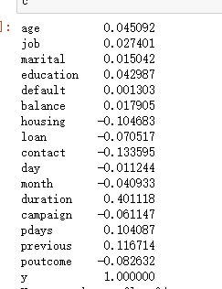
Heatmap
Most of them is between 0.4-0.4(not very strong relation)
From the above plot we can observe that most of the features are independent of each other.
Feature-pair (pdays - previous) is highly negatively correlated.
Therefore we can remove “pdays”.

Slide 12
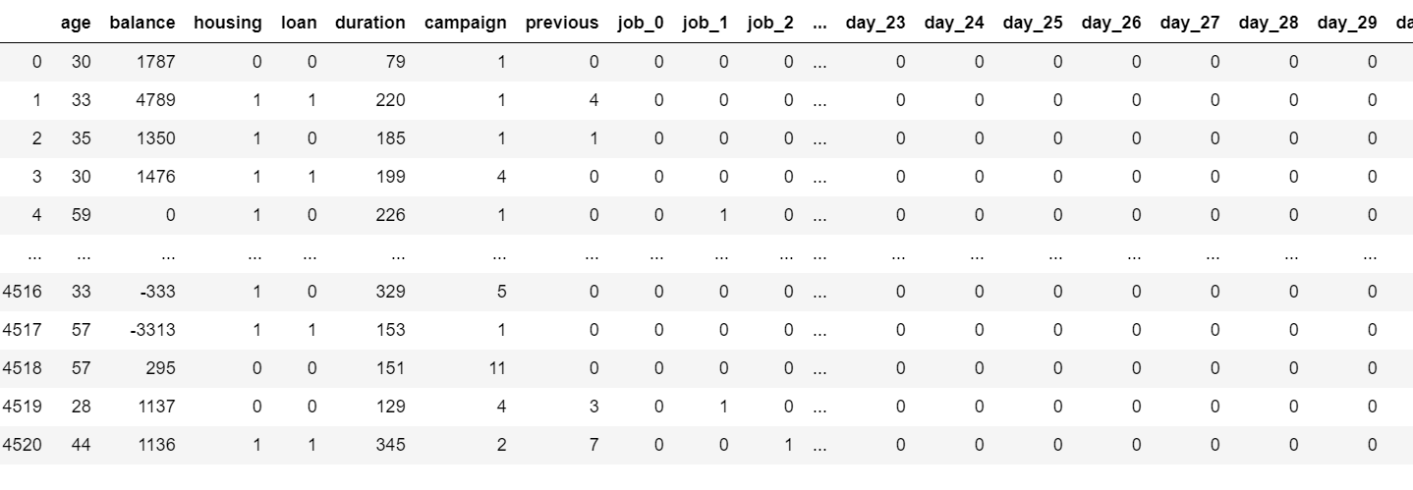
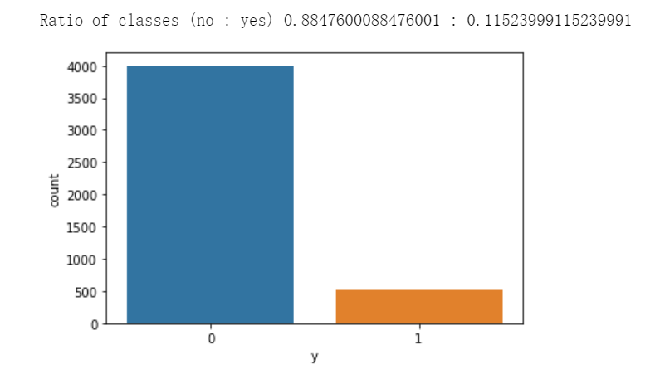
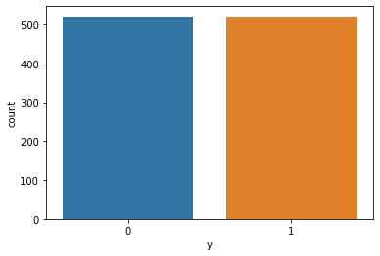
One hot encoding
The features are encoded using a one-hot(aka ’one-of-K’ or ‘dummy’)encoding scheme.
This creates a binary column for each category
Data balance:
Unbalance data will influence classification algorithms
makes classification more towards on the category that contain large data
Accuracy require balanced data
Before balancing
After Balancing
521
521
4000
521

Slide 13
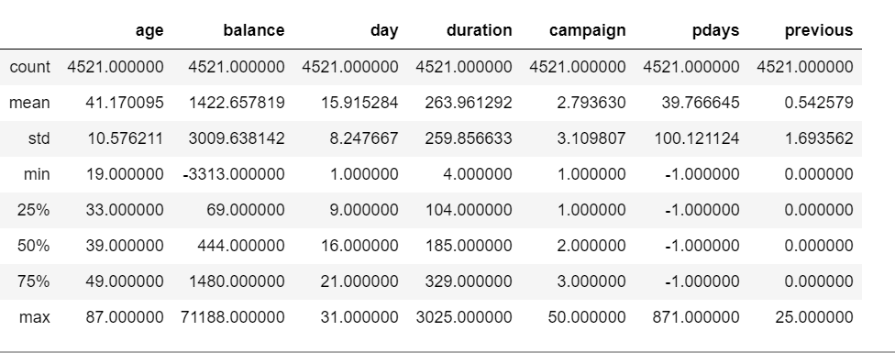
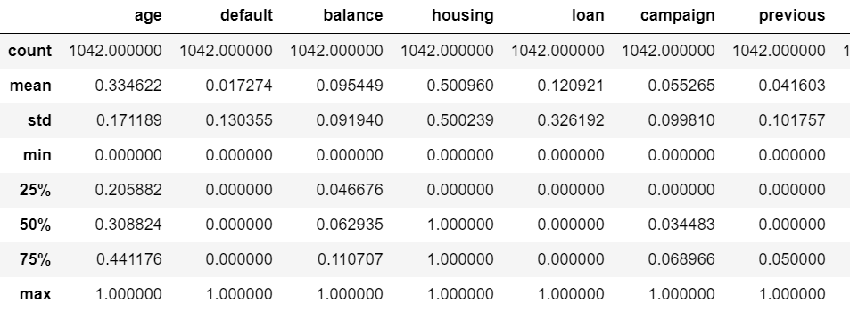
Feature scaling: MinMax scaler()
1. This making algorithms perform better or coverage faster when features are on a relatively similar scale and closed to normally distributed.
2. Scaling can help features arrive in more digestible form for these algorithms, helping in speeding up the calculations Such as SVM, Multinomial naïve Bayes. Theoretically, it would not influence Random forest.
before
after

Slide 14
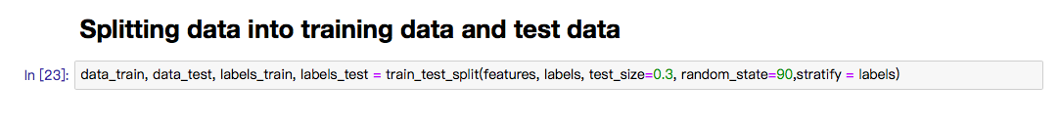
3.Algorithms and Techniques
GridSearchCV function was used to apply cross validation on different combinations of parameters.
The socring we used is accuracy.

Slide 15

3.1 Gaussian Naive Bayes
Assumption of Gaussian Naive Bayes:
Features are independent variables
Each feature follows Gaussian distribution
Accuracy on test data is: 0.584665

Slide 16
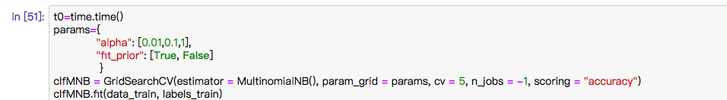
3.2 Multinomial Naive Bayes
Alpha:
Additive (Laplace/Lidstone) smoothing parameter.
Fit_prior:
Whether to learn class prior probabilities or not.
Best parameters of GridSearch: 'alpha': 0.01, 'fit_prior': True
Accuracy on test data is: 0.661342

Slide 17
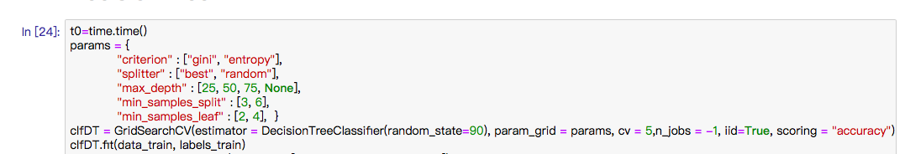
3.3 Decision Tree
Best parameters of GridSearch:
-'criterion': 'gini', 'max_depth’: 25, 'min_samples_leaf’: 4,
'min_samples_split’: 3, 'splitter': ‘best’
Accuracy on test data is: 0.731629

Slide 18
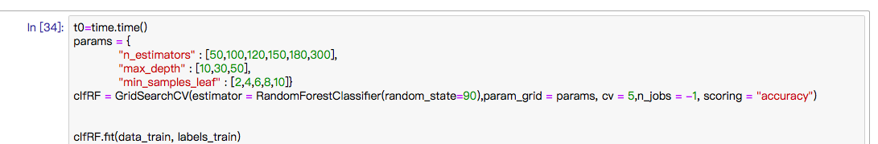
3.4 Random Forest
n_estimators:The number of trees in the forest.
max_depth:The maximum depth of the tree. If None, then nodes are expanded until all leaves are pure or until all leaves contain less than min_samples_split samples.
min_samples_leaf:The minimum number of samples required to be at a leaf node.
Best parameters of GridSearch: 'max_depth’: 10, 'min_samples_leaf': 2, 'n_estimators’: 120
Accuracy on test data is: 0.789137

Slide 19
3.5 Support Vector Machine
SVM | Parameters | Best_params | Accuracy_score
Linear | {"C": [0.005, 0.1, 1, 5, 10], "kernel": ["linear"]} | {'C': 1, 'kernel': 'linear'} | 0.753994
RBF | {"C": [0.005, 0.1, 1, 5, 10],"kernel": ["rbf"], "gamma": [0.0001, 0.001, 0.005, 0.1, 1, 3, 5]} | {'C': 5, 'gamma': 0.1, 'kernel': 'rbf'} | 0.782748
Poly | {"C": [0.005,0.1, 1, 5, 10], "kernel":["poly"], "gamma": [0.0001, 0.001, 0.005, 0.1, 1, 3, 5]} | {'C': 0.005, 'gamma': 5, 'kernel': 'poly'} | 0.750799

Slide 20
4.1 Training Time
4.Comparison for the ML techniques
time.time() –not stable×
%%timeit(7 runs )-accurate√
Comparison based on %%timeit↓
Precedures:
Apply %%timeit(7 runs ) to calculate training times for each machine learning technique
Outcome:
Pace: Gaussian Naïve Bayes ＞ Multinomial Naïve Bayes ＞ Decision Tree ＞ SVM-linear ＞ SVM-poly ＞ SVM-rbf ＞ Random Forest
Classifier | Training Time (per loop)
Gaussian Naïve Bayes | 4.85 s ± 29 ms
Multinomial Naïve Bayes | 5.06 s ± 140 ms
Decision Tree | 7.52 s ± 221 ms
SVM-linear | 10.1 s ± 277 ms
SVM-poly | 30.5 s ± 906 ms
SVM-rbf | 33.4 s ± 850 ms
Random Forest | 2min 2s ± 2.07 s

Slide 21
4.2 Accuracy
Premise:
Metric: Accuracy
GridsearchCV: Scoring = accuracy
Outcome:
Random Forest ＞ SVM-rbf ＞ SVM-linear ＞ SVM-poly ＞ Decision Tree ＞ Multinomial Naïve Bayes ＞ Gaussian Naïve Bayes

Slide 22
4.3 Learning Curve
Reason:
1. Sanity check: Whether the model is underfitting or overfitting?
2. Better Choice: Which are better machine learning techniques?

Slide 23
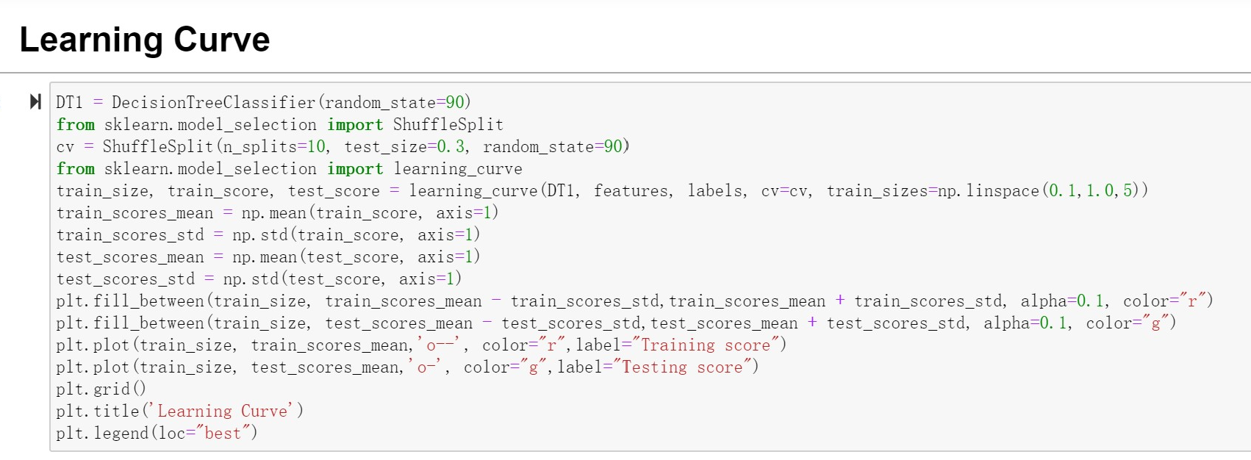
4.3 Learning Curve
Precedures:
Define cv : test_size = 0.3
Plot: Training score &Testing score
Reason:
1. Sanity check: Whether the model is underfitting or overfitting
2. Better Choice: relatively accurate machine learning techniques

Slide 24
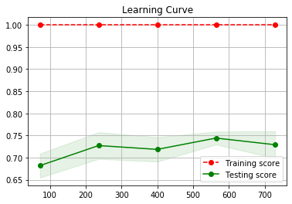
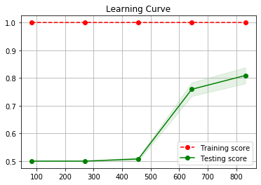
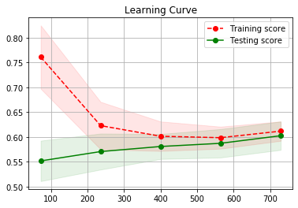
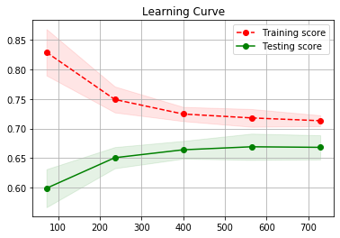
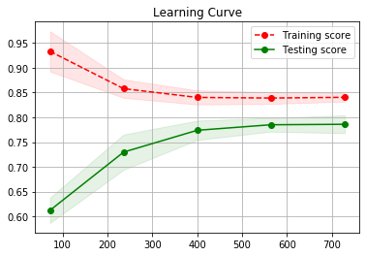
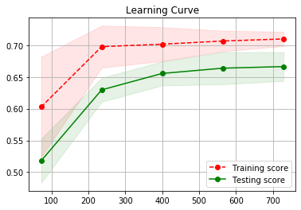
4.3 Learning Curve
Begin to drop
Point:
Underfitting or Overfitting;
Not very good:
Decision Tree
GaussianNB
Red:
Training Score
Green:
Testing Score
Decision Tree
Random Forest
Relatively low
here
GaussianNB
MultinomialNB
SVM-linear
SVM-rbf
SVM-poly

Slide 25
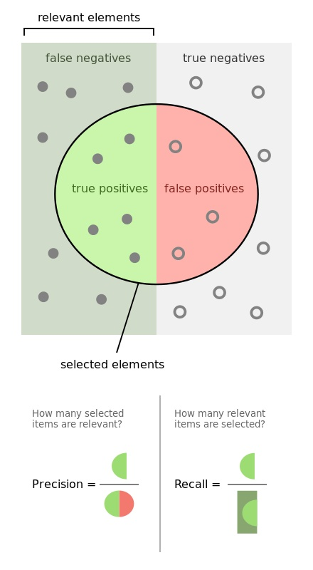
4.4 Recall & Precision
Reason:
Recall deserves to be an important measurement indicator.
-FN is better to be smaller.
-Recall is better to be higher.
Higher Recall means the model may sacrifice Precision.
-Precision also needs to be relatively reasonable.
https://en.wikipedia.org/wiki/Precision_and_recall

Slide 26
4.4 Recall & Precision
Outcome:
Recall: Random Forest ＞ SVM-rbf ＞ SVM-linear
Precision: Gaussian Naïve Bayes ＞ SVM-rbf ＞ Random Forest

Slide 27
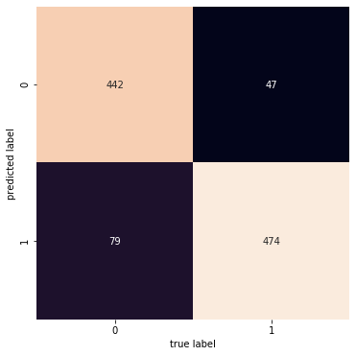
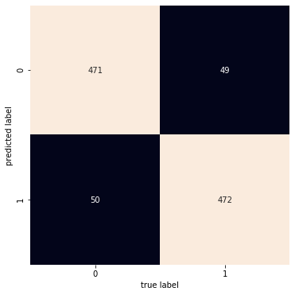
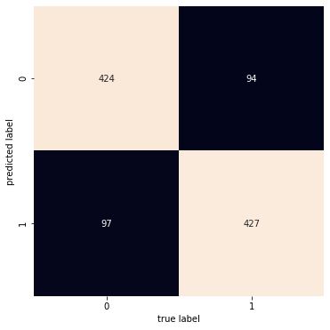
4.4 Recall & Precision
FN: 47, 49, 94
Outcome:
Recall: Random Forest ＞ SVM-rbf ＞ SVM-linear
Precision: Gaussian Naïve Bayes ＞ SVM-rbf ＞ Random Forest
Random Forest
SVM-rbf
SVM-linear

Slide 28
4.4 Recall & Precision
Outcome:
Recall: Random Forest ＞ SVM-rbf ＞ SVM-linear
Precision: Gaussian Naïve Bayes ＞ SVM-rbf ＞ Random Forest

Slide 29
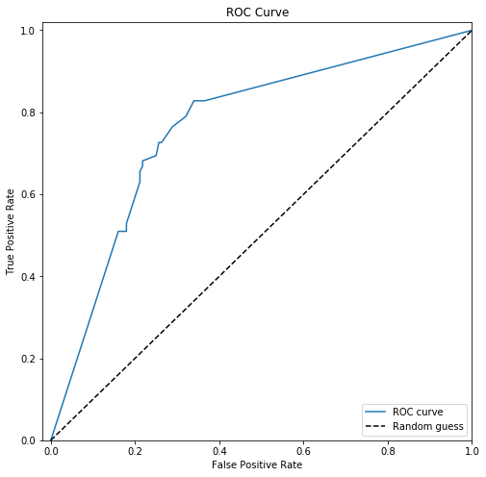
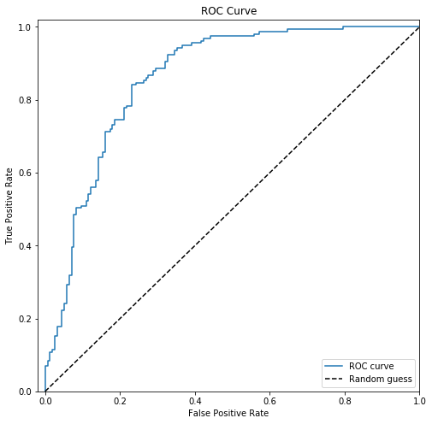
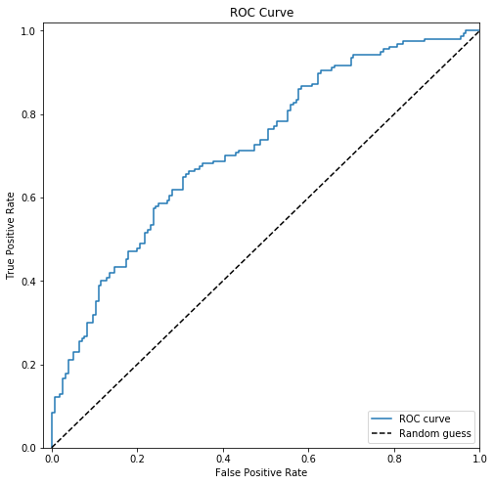
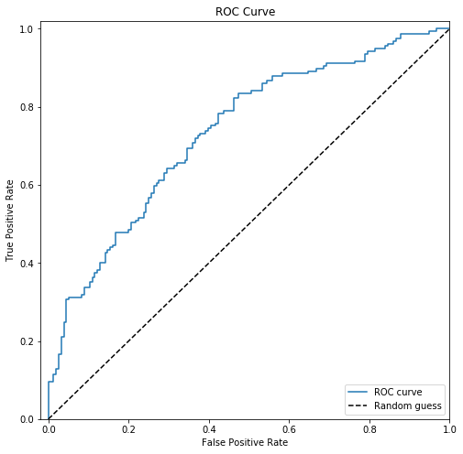
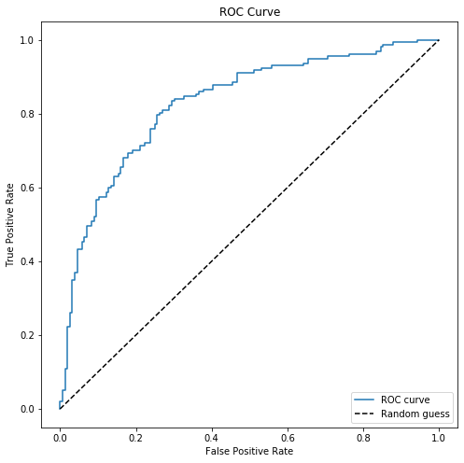
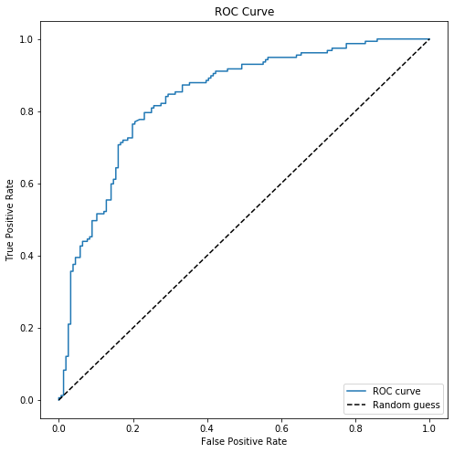
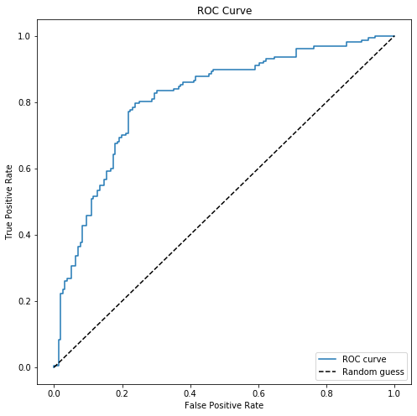
4.5 ROC-Curve
ROC: y = TPR; x = FPR. Ideal: y>x
AUC = Area Under The Curve
Reason:
An excellent model has AUC near to the 1 which means it has good measure of separability ( Not impacted if classes are imbalanced).
Outcome:
Random Forest ＞ SVM-rbf ＞ SVM-linear
Decision Tree
Random Forest
GaussianNB
MultinomialNB
SVM-linear
SVM-rbf
SVM-poly

Slide 30
4.5 ROC-Curve
ROC: y = TPR; x = FPR. Ideal: y>x
AUC = Area Under The Curve
Reason:
An excellent model has AUC near to the 1 which means it has good measure of separability ( Not impacted if classes are imbalanced).
Outcome:
Random Forest ＞ SVM-rbf ＞ SVM-linear

Slide 31
Mark the top three in each Metrics
Classifier |  | Accuracy | Precision | Recall | F1 | AUC | Pace
Random Forests | Decision Tree | 0.731629 | 0.758865 | 0.681529 | 0.718121 | 0.731790 | 3
 | Random Forest | 0.789137 | 0.779141 | 0.808917 | 0.793750 | 0.789074 | 7
Naïve Bayes | GaussianNB | 0.584665 | 0.787234 | 0.235669 | 0.362745 | 0.585783 | 1
 | MultinomialNB | 0.661342 | 0.662420 | 0.662420 | 0.662420 | 0.661338 | 2
Support Vector Machine | SVM-linear | 0.753994 | 0.759740 | 0.745223 | 0.752412 | 0.754022 | 4
 | SVM-rbf | 0.782748 | 0.787097 | 0.777070 | 0.782051 | 0.782766 | 6
 | SVM-poly | 0.750799 | 0.768707 | 0.719745 | 0.743421 | 0.750898 | 5
Not
recommended
Not
recommended

